Slide 1
Chapter 5
Demand
© 2019 McGraw-Hill Education. All rights reserved. Authorized only for instructor use in the classroom. No reproduction or distribution without the prior written consent of McGraw-Hill Education.

Slide 2
Learning Objectives
Relate the law of demand to the Cost-Benefit Principle.
Discuss how individual wants are translated into demand using utility maximization.
Explain the reasoning behind the rational spending rule and apply it to consumer decision making to show how the rule is related to substitution and income effects.
Discuss the relationship between the individual demand curve and the market demand curve.
Define and calculate consumer surplus.

Slide 3
Free Ice Cream – Or Is It?
The cost of a good extends beyond its monetary cost
Waiting in line
Purchasing a permit
Participating in a lottery
"Free" ice cream attracts so many consumers that the time spent waiting in line acts as the price of the good
Demand curves relate the quantity demanded to ALL costs, not just monetary costs

Slide 4
Law of Demand 1
Law of Demand People do less of what they want to do as the cost of doing it rises

Slide 5
Law of Demand 2
Cost-Benefit Principle at work
Do something if the marginal benefits are at least as great as the marginal costs
An increase in the market price approaches our reservation price
If market price exceeds the reservation price, buy no more
Costs include ALL costs – money, time, reputation
Consider implicit and explicit costs

Slide 6
Origins of Demand
Reservation price
Individual tastes and preferences differ
Biological needs
Peer behavior
Perceived quality
Cultural influences
Individual differences
Expected benefits
Tastes may change over time
Macaroni and cheese
Spinach
New goods get incorporated into priorities

Slide 7
Needs Versus Wants
Some goods are required for subsistence
These are needs
Beyond subsistence, behavior is driven by wants
Kidneys or hamburger
Oatmeal or toaster pastries
Wants depend on price
Water in California
Regulations or price mechanism
Regulations are cumbersome and expensive
Price changes are fast and effective

Slide 8
California Water Shortages
Problem: California has a large population and relatively low annual rainfall, so some argue that water shortages are inevitable
Analysis
New Mexico has less rainfall per person and fewer shortages
California's water price is low
Low price discourages careful use
Rice and almonds are grown because water is cheap
Water-intensive home landscaping

Slide 9
Wants and Demand
Unlimited wants
More things, better quality things
Services, including entertainment and travel
Limited resources
Money, income, and wealth
Time and energy
Prioritize wants
Allocate resources accordingly
Demand those things for which you are willing and able to pay

Slide 10
Wants and Utility
Utility: the satisfaction people derive from consumption
Well-being, happiness
Measured indirectly
Subjective
Observable
Cannot be compared between people
Individual goal is to maximize utility
Allocate resources accordingly

Slide 11
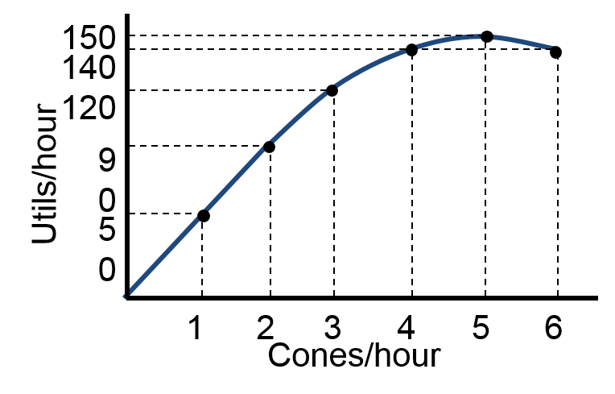
Sarah's Utility from Ice Cream
Cones / Hour | 0 | 1 | 2 | 3 | 4 | 5 | 6
Total Utility | 0 | 50 | 90 | 120 | 140 | 150 | 140

Slide 12
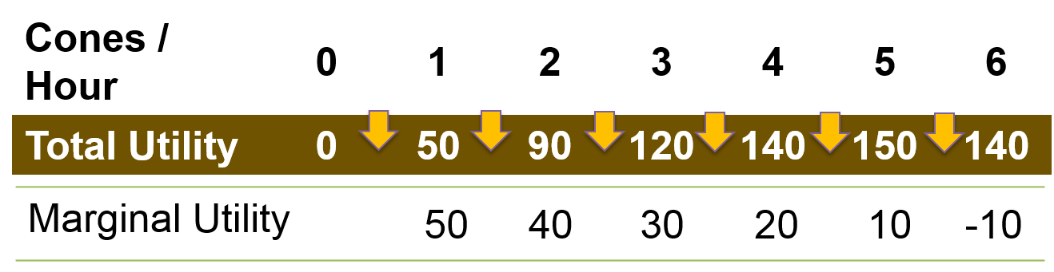
Sarah's Marginal Utility from Ice Cream
Marginal utility: the additional utility from consuming one more

Slide 13
Diminishing Marginal Utility 1
Law of Diminishing Marginal Utility Tendency for additional utility gained from consuming an additional unit of a good to decrease as consumption increases beyond some point

Slide 14
Diminishing Marginal Utility 2
Marginal utility can increase at low levels of consumption
First unit stimulates your desire for more
First MP-3 player in a 5-person household
First potato chip
Eventually marginal utility declines
Continue consuming
Apply Cost-Benefit Principle
Consume an additional unit as long as the marginal utility (benefit) is greater than the marginal cost

Slide 15

Spending on Two Goods
Assume a fixed budget
Decide how much of each good to buy
Law of Diminishing Marginal Returns applies
As you buy more of a single good, its marginal utility decreases
When you buy less of that good, its marginal utility increases
Remember, marginal utility is not satisfaction overall but satisfaction from consuming one more

Slide 16
Budget Allocation
Maximize utility when the marginal utility per dollar spent is the same for all goods
No Cash On the Table Principle
Current spending has marginal utility of a dollar spent on one good higher than the marginal utility of a dollar spent on the other good
Take a dollar away from the good with low marginal utility and spend it on the good with high marginal utility
Marginal utilities per dollar begin to equalize

Slide 17
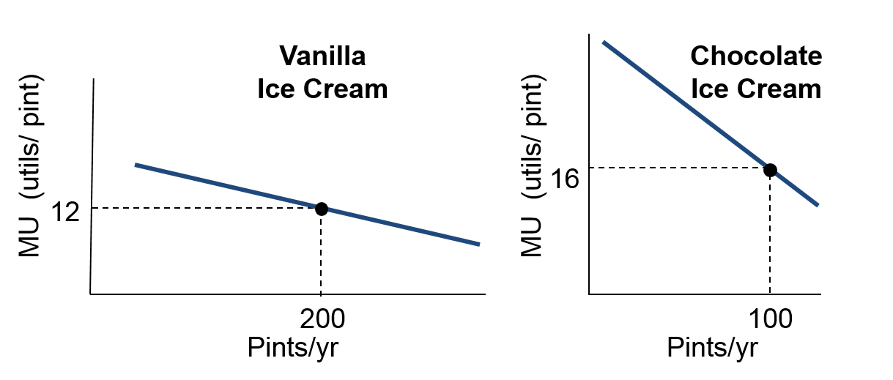
Sarah’s Ice Cream
$400 budget
Chocolate is $2 per pint
Vanilla is $1 per pint
Buy 200 pints of vanilla and 100 pints of chocolate
Marginal utility is 12 for vanilla, 16 for chocolate

Slide 18
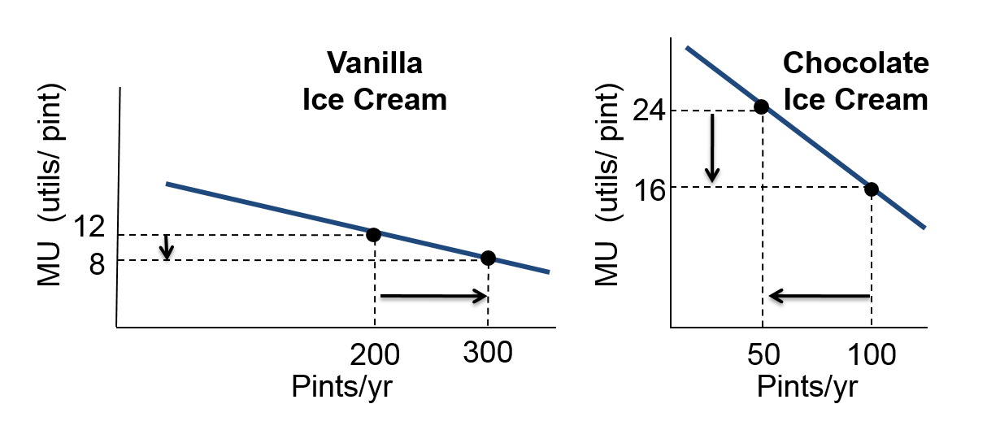
Sarah’s Next Step
Increase vanilla by 100
Reduce chocolate by 50
Marginal utility of vanilla is 8
Marginal utility of chocolate is 24

Slide 19
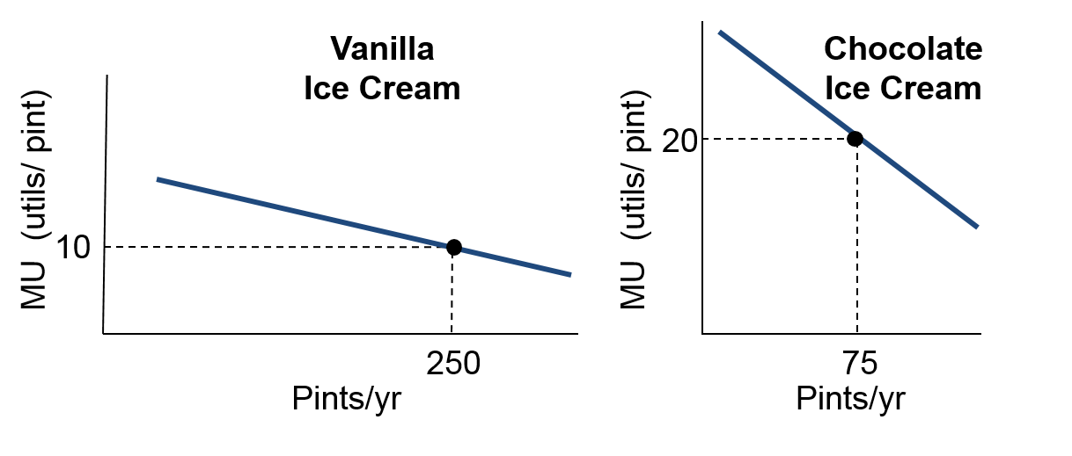
Sarah’s Equilibrium
Optimal combination: highest total utility
250 pints vanilla; 75 pints chocolate
Marginal utility / price is the same for all goods
Marginal utility of vanilla 10, chocolate 20

Slide 20
Sarah’s Choices
Scenario 1 | Price | Quantity | Marginal Utility | MU / $
Vanilla | $1 | 200 | 12 | 12
Chocolate | $2 | 100 | 16 | 8
Scenario 2 | Price | Quantity | Marginal Utility | MU / $
Vanilla | $1 | 300 | 8 | 8
Chocolate | $2 | 50 | 24 | 12
Scenario 3 | Price | Quantity | Marginal Utility | MU / $
Vanilla | $1 | 250 | 10 | 10
Chocolate | $2 | 75 | 20 | 10

Slide 21
Rational Spending Rule 1
The Rational Spending Rule
Spending should be allocated across goods so that the marginal utility per dollar is the same for each good

Slide 22
Rational Spending Rule 2
Rational Spending Rule can be written algebraically
Notation
MU_{C} is the marginal utility from chocolate
MU_{V} is the marginal utility from vanilla
P_{C} is the price of chocolate
P_{V} is the price of vanilla
Rational Spending Rule
MU_{C} / P_{C} = MU_{V} / P_{V}
The marginal utility per dollar spent on chocolate equals the marginal utility per dollar spent on vanilla

Slide 23
Substitution Effect
When the price of a good goes up, substitutes for that good are relatively more attractive
At the higher price less is demanded because some buyers switch to the substitute good
If the price of vanilla ice cream goes up, some buyers will buy less vanilla and more chocolate

Slide 24
Income Effect
Changes in price affect the buyers' purchasing power
Acts like a change in income
Suppose vanilla ice cream goes from $1 per pint to $2
If Sarah spends all her income on vanilla, the amount she can buy goes down by half
At the original prices, she could buy 100 pints of vanilla and 150 pints of chocolate
At new price for vanilla, she buys 100 vanilla and only 100 chocolate

Slide 25
Rational Spending and Price Changes
Suppose price of vanilla increases from $1 to $2
At the original equilibrium
MU_{C} / P_{C} = MU_{V} / P_{V}
With the increase in P_{V}, MU_{V} / P_{V} < MU_{C} / P_{C}
If Sarah buys more chocolate, MU_{C} will go down
If Sarah buys less vanilla, MU_{V} will go up
To get to a new optimal spending point,
Buy more chocolate
Buy less vanilla
Stop when the marginal utility per dollar is the same

Slide 26
Chocolate Ice Cream Price Goes Down
Originally: $400 budget, $1 per pint for vanilla, and $2 per pint for chocolate
What if chocolate is now $1 per pint?
With the increase in P_{V},
MU_{V} / P_{V} > MU_{C} / P_{C}
If Sarah buys more chocolate, MU_{C} will go down
If Sarah buys less vanilla, MU_{V} will go up
To get to a new optimal spending point,
Buy more chocolate
Buy less vanilla
Stop when marginal utility per dollar is the same

Slide 27
Eric’s Apples
 | Apples | Oranges
Total Expenditures | $100 | $50
Price | $2 | $1
Total Utility | 1,000 | 400
Quantity | 50 | 50
Is Eric following the Rational Spending Rule?

Slide 28
Applying the Rational Spending Rule: Substitution at Work
Substitution has powerful effects on our choices
New car or used one
Car pool or bus
French restaurant, Chinese restaurant, cook at home
Soccer game or TV or read a book
Go to movies or join Netflix or get cable TV
Turn on the heat or put on a hoodie

Slide 29
Example: Smaller Homes in Manhattan
Observation: Wealthy people in Seattle have larger homes than wealthy people in Manhattan
Seattle houses twice the size of Manhattan houses
Analysis
Housing prices are higher in Manhattan
Land is more expensive
Construction costs are higher
New Yorkers buy less housing and spend more on other goods such as vacation homes, travel, restaurant meals, and theater tickets

Slide 30
Nominal and Real Prices
Nominal price: the absolute price of a good in terms of dollars
The price you see on a good in a store
Real price: the nominal price of a good relative to the average dollar price of all other goods
Real prices are adjusted for inflation

Slide 31
Example: How Many Cylinders in Your Car?
Observation: People bought 4-cylinder cars in the 1970s, returning to 6- and 8-cylinder cars in the 1990s
Analysis
 | 1973 | 1974 | 1979 | 1999
Gas Price | $0.38 | $0.90 | $1.19 | $1.40
 | 1973 | 1974 | 1979 | 1999
1973 gas price was higher in real terms than in 1999
$1.40 in 1999 bought more other goods than $0.38 bought in 1973
With lower real gas prices, people bought bigger cars
SUV market boomed in the 1990s
High gas prices in 2004 reversed the trend again

Slide 32
Income Differences Matter
Income is one of the determinants of demand
"Free goods" have more takers in lower income neighborhoods than in higher income areas
The wait to get the free good is the price
Waiting times in lower income areas will be longer
Lower opportunity cost of the residents' time
Stores in higher income areas have lower waiting times to pay for purchases
The higher value of time causes these people to be willing to pay for more store staff

Slide 33
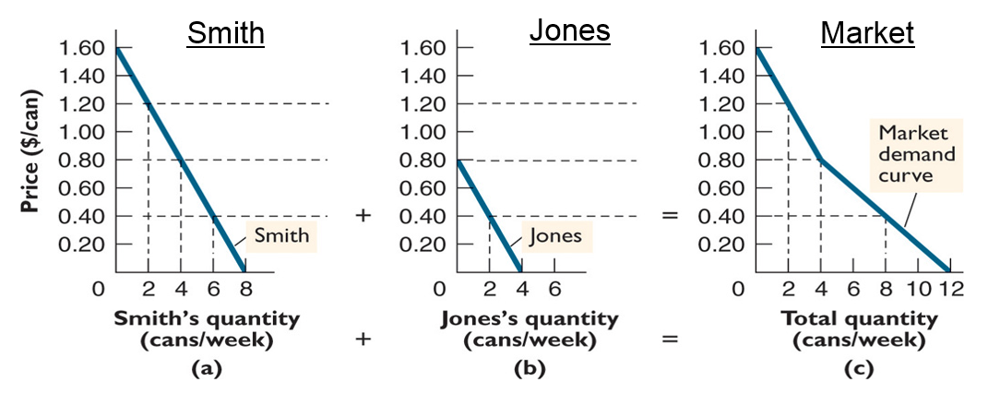
Individual and Market Demand Curves
The market demand is the horizontal sum of individual demand curves
At each possible price, add up the number of units demanded by individuals to get the market demand

Slide 34
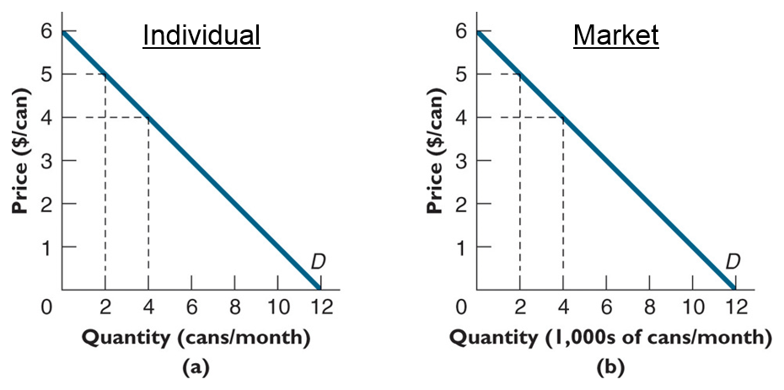
Identical Individual Demand Curves
In the special case where all buyers demand exactly the same quantity at each price
Multiply the individual quantity demanded by the number of buyers to get the market demand

Slide 35
Consumer Surplus
Consumer surplus is the difference between the buyer's reservation price and the market price
With multiple buyers
Find the consumer surplus for each buyer
Add up the individual surplus for each buyer

Slide 36
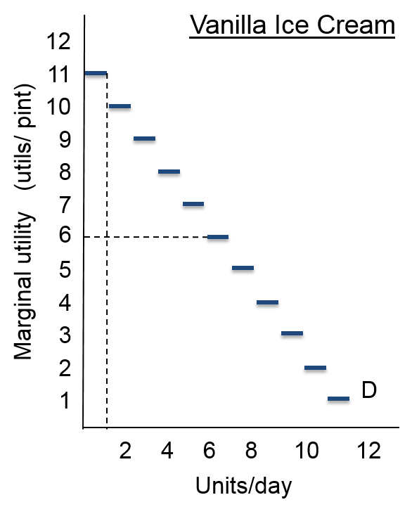
Consumer Surplus on a Graph 1
When a product is sold in whole units, the demand curve is a stair-step function
Many goods are indivisible: movie tickets and TVs
If the market supplied only one unit, the maximum price would be $11
For the second unit, the price is $10, and so on
The last buyer gets no consumer surplus

Slide 37
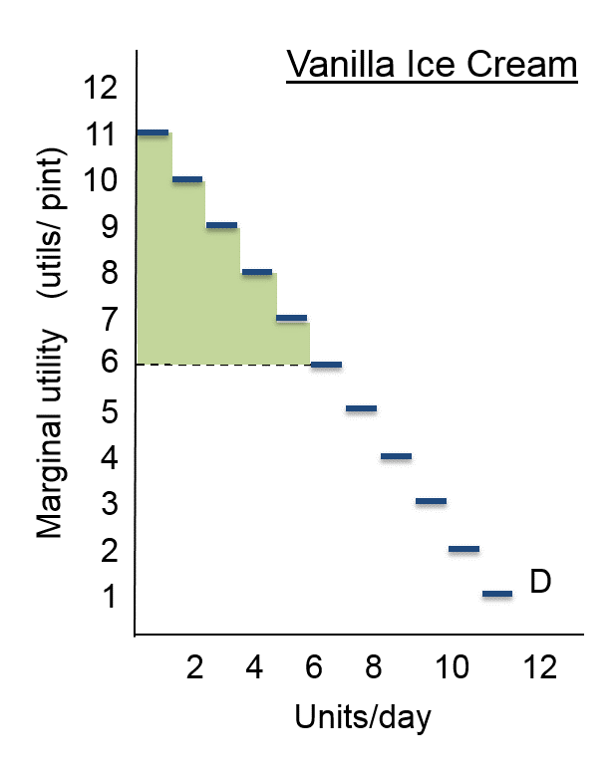
Consumer Surplus on a Graph 2
Market price is $6 for all sales
Total consumer surplus
The first sale generates $5 of consumer surplus
Reservation price of $11 minus the price of $6
Selling the second unit has $4 of consumer surplus, and so on
Total consumer surplus is the area under the demand curve and above market price

Slide 38
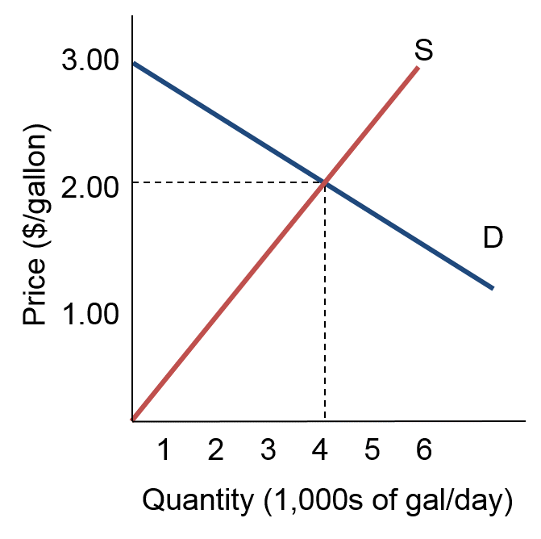
Consumer Surplus for Milk 1
Consider the market demand and supply of milk
The equilibrium price is $2 per gallon
The equilibrium quantity is 4,000 gallons per day
Last customer pays his reservation price and gets no consumer surplus

Slide 39
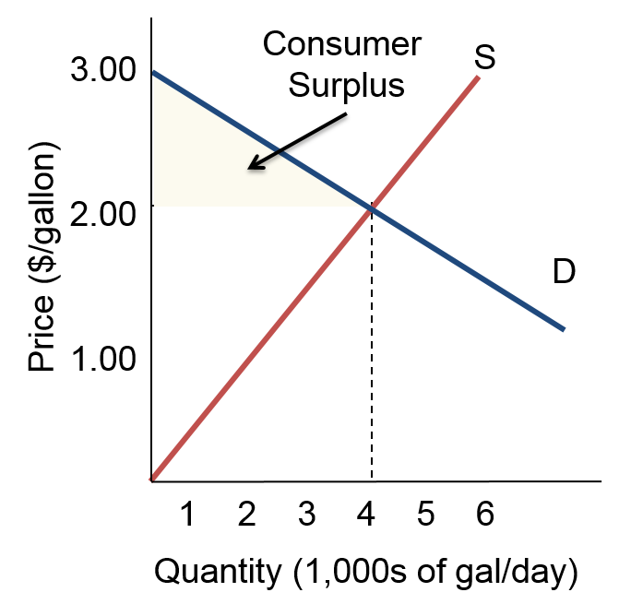
Consumer Surplus for Milk 2
Price is $2 and quantity is 4,000 gallons per day
Consumer surplus is the area of the triangle between:
Horizontal intercept of demand
Market price
Market quantity
Remember: area of a right triangle is ½ base times height
The area is ½ (4,000 gal)($3−$2) = $2,000

Slide 40
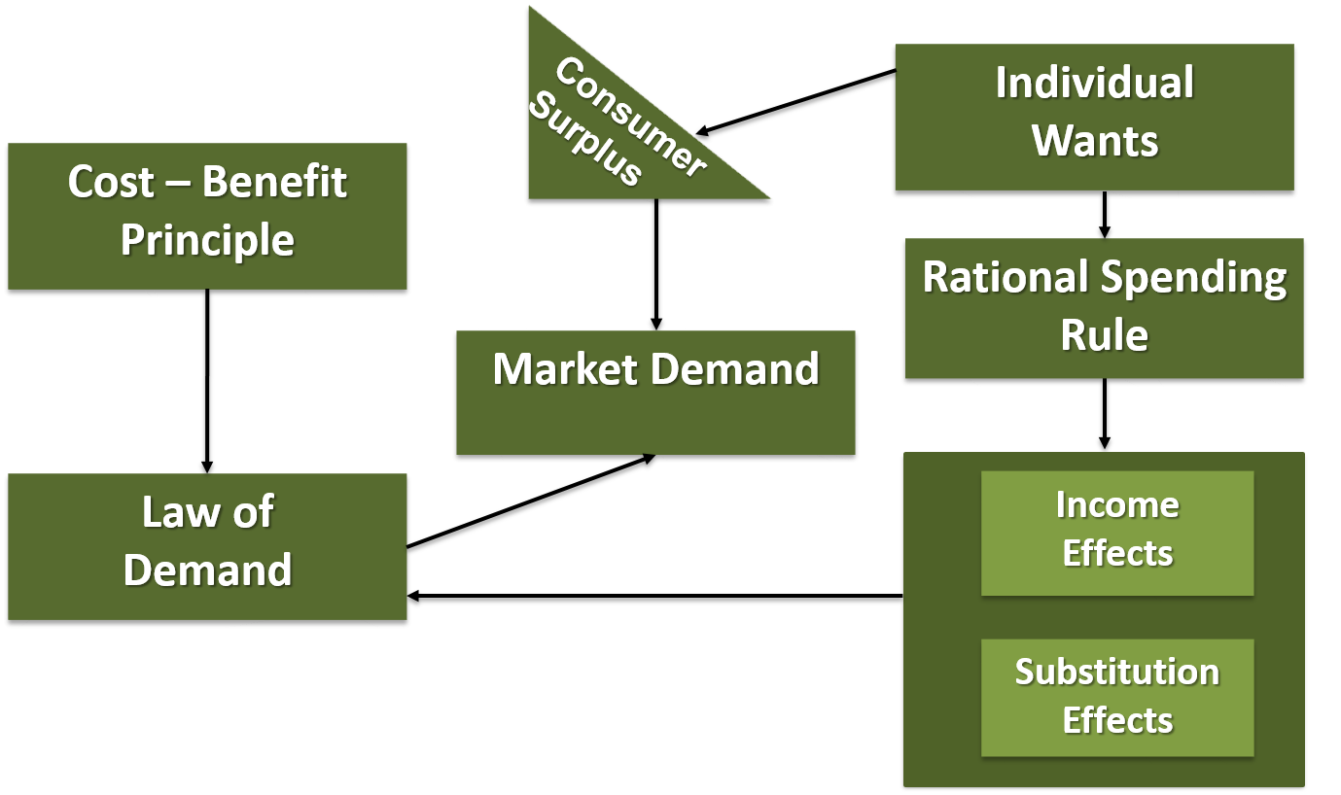
Demand

Slide 41
Chapter 4 Appendix
Indifference Curves
© 2019 McGraw-Hill Education. All rights reserved. Authorized only for instructor use in the classroom. No reproduction or distribution without the prior written consent of McGraw-Hill Education.

Slide 42
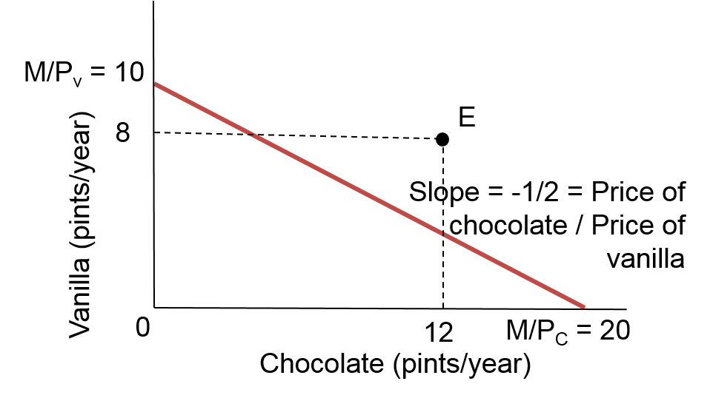
Budget Constraints
The budget constraint describes the different bundles you can afford, sort of like a PPF
If M is your budget and P_{v} is the price of vanilla, you can afford at most M/P_{v} units of vanilla.
Lets you see what bundles are affordable (E isn’t!)

Slide 43
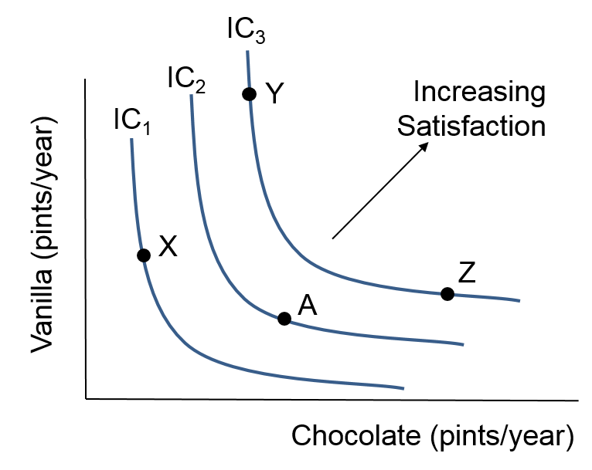
Consumer Preferences
Indifference curves describe the set of bundles you’d be indifferent between
Slope is MU_{x}/MU_{y} = MRS (marginal rate of substitution)
A higher indifference curve is preferred to a lower one

Slide 44
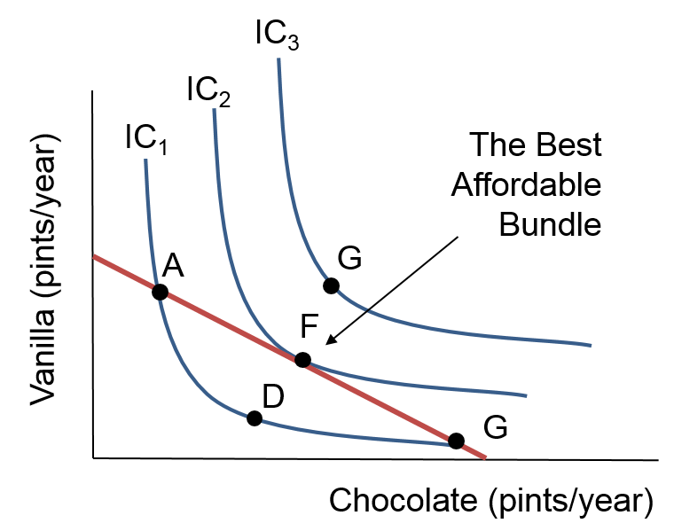
Best Affordable Bundle
The budget constraint says what you can afford
Higher indifference curves are better
So the point on the highest indifference curve you can reach with your budget constraint is your best affordable bundle
MRS = P_{c}/P_{v}, the same as the rational spending rule.

